Slide 1


Business Order
Just a regular order shipment on some products the museum

Slide 2
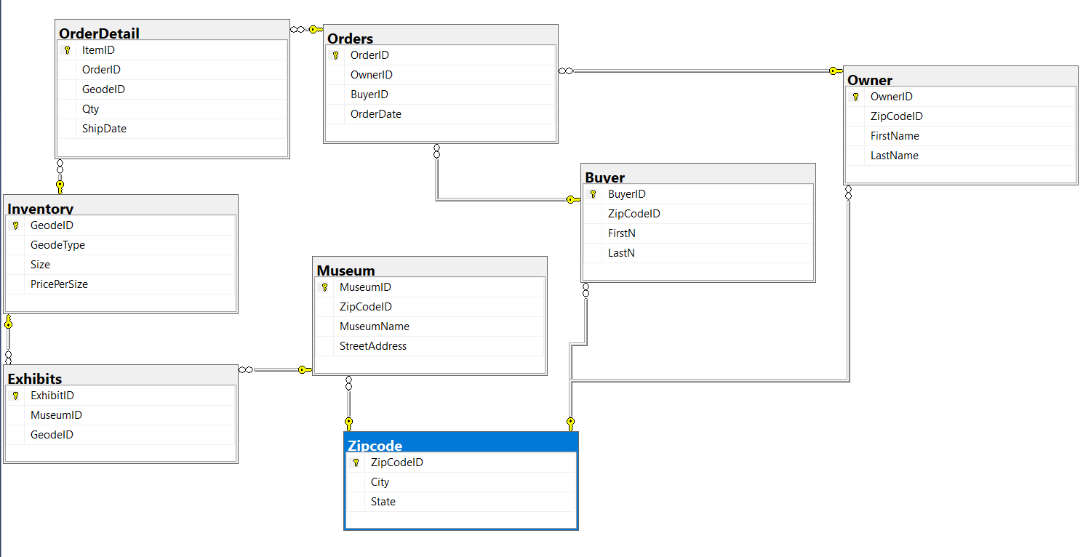
Database Diagram

Slide 3
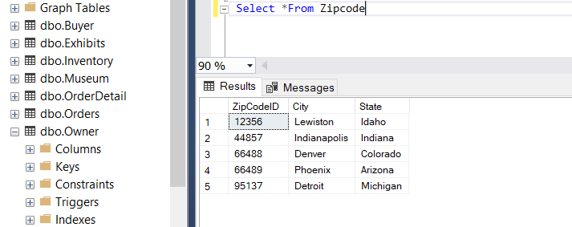
Zipcode Table

Slide 4
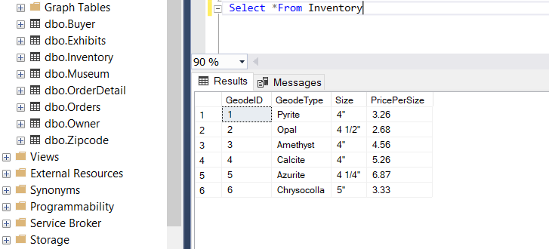
Inventory Table

Slide 5
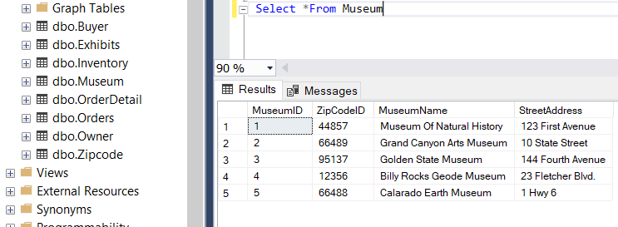
Museums Table

Slide 6
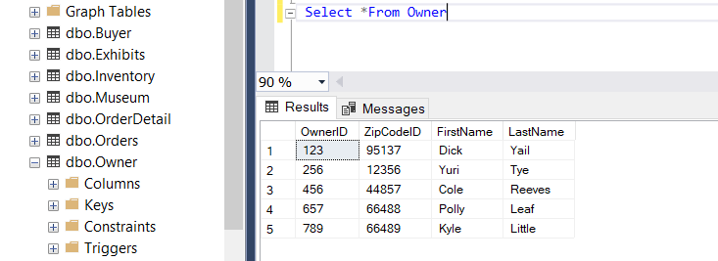
Museum Owners Table

Slide 7
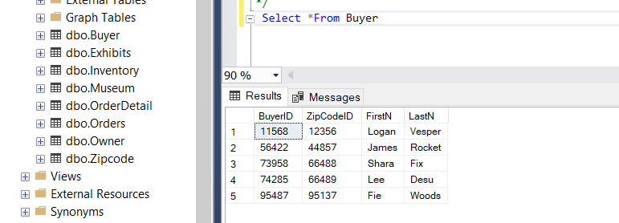
Buyers Table

Slide 8
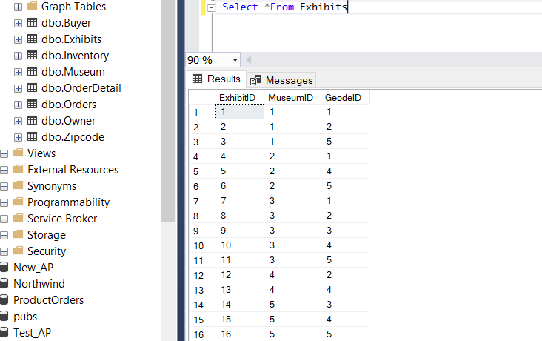
Exhibits Table

Slide 9
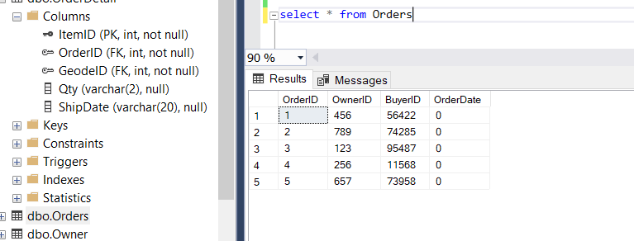
Orders (made)

Slide 10
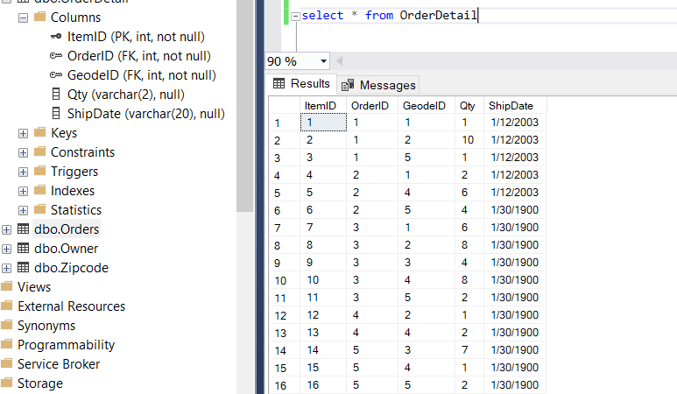
Overall OrderDetail

